Slide 1
Hierarchical Clustering
Renato R. Maaliw III, DIT
College of Engineering
Southern Luzon State University
Lucban, Quezon, Philippines

Slide 2
Hierarchical Clustering (HC)
HC is a special way of grouping things where we start with everything in its own group, and then we slowly combine the most similar group until there’s just one big group

Slide 3
Think of it like building a family tree:
At the bottom, every person starts alone
As you go up, people are connected based on who is most closely related to them
At the top, all the people are connected in one big family

Slide 4
In HC:
every data point starts in its own “family”
then we merge the closest data points or clusters together step by step
this process continues until everything is in one big “family”

Slide 5
Example: Grouping Friends
Imagine you have 10 friends, and you want to group them based on how much time they spend together. Here’s how HC works:

Slide 6
Start with individuals: At first, each friend is in their own group
Find the closest friends: You check which two friends spend the most time together and group them.

Slide 7
Keep Grouping: Then you check which group of friends is closest to another and keep combining the groups.
One Big Group: At the end, you have one big group than shows how all the friends are connected to each other.

Slide 8
Dendrogram:
The Tree of Clusters

Slide 9
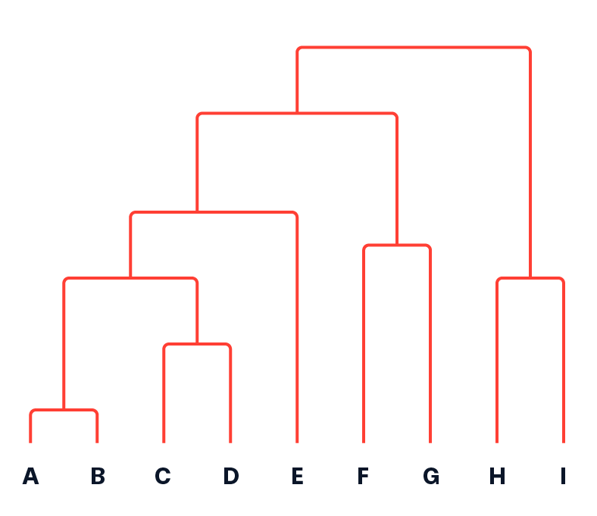
Now, let’s talk about the dendrogram, which is just a fancy word for the tree that HC creates.
You can "cut" this tree at any height to decide how many groups of friends you want.
If you cut it higher, you get fewer, larger groups. If you cut it lower, you get more, smaller groups.

Slide 10
Types of HC:
Agglomerative (Bottom-Up Approach): Start with each thing (or person) in its own group and merge until there’s just one big group.
Divisive (Bottom-Up Approach): Start with one big group and split it into smaller groups. This is like starting with a whole group of friends and slowly dividing them into smaller cliques.

Slide 11
How do we know which cluster (friends) are closest?
1. Euclidean Distance: This is like drawing a straight line between two points on a map and measuring the distance. If two friends live close together, they’re probably more likely to hang out.

Slide 12
How do we know which cluster (friends) are closest?
2. Manhattan Distance: Imagine walking only along streets on a grid, like in a city. This is another way of measuring how far things are.

Slide 13
Linkage Methods: How Do We Merge Groups?
When we start merging groups of friends, we need to decide how to measure the distance between groups, not just between individual people. Here are three ways we can do this:

Slide 14
1. Single Linkage
We look at the two closest people in each group and use that distance.

Slide 15
2. Complete Linkage:
We look at the two farthest people in each group and use that distance.

Slide 16
3. Average Linkage:
We find the average distance between all the people in the two groups.
* We usually use Ward’s Method, which tries to make groups that are nice and balanced. *

Slide 17
4. Ward's Method:
Minimizes the total variance within clusters.:
* We usually use Ward’s Method, which tries to make groups that are nice and balanced. *

Slide 18
Thank you very much for listening.

